Slide 1
Design Concepts

Slide 2
Software Design
Iterative process
More detailed design after each iteration
Design: Convert user requirements to blueprints which helps the programmer in software implementation.
The design model shows:
software architecture,
interfaces,
components used.

Slide 3
Software Design
Component level design
Defines the procedural components that can be developed using class design
Interface design
Defines data flow between human and machine. Done using behavioral analysis and usage scenarios.
Architectural design
Defines framework of a computer based system; standalone / distributed etc.
Data / class design
Define class attributes, objects and relationship defined in CRC (class responsibility collaborator) models

Slide 4
Software Design
Component level design
DFD, sequence diag., state transition diag., class diagram
Interface design
Use case diag., state transition diag. ,sequence diag. , DFDs
Architectural design
Class diagram, CRC, collaboration diag., DFD, control flow diag.
Data / class design
Class diagram, CRC, collaboration diag.

Slide 5
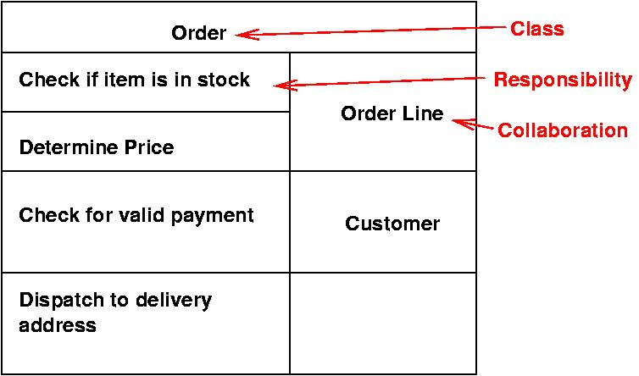



Slide 6
Good Software Design characteristics
Firmness:
Commodity:
Delight:
program should not have any bugs that inhibit its function.
A program must serve the purpose for which it is designed.
The user experience should be pleasurable one.

Slide 7
Quality Guidelines
A design should be modular; that is, the software should be logically partitioned into elements or subsystems
A design should contain distinct representations of data, architecture, interfaces, and components.
A design must use appropriate data structures for the classes to be implemented.
A design should lead to components that exhibit independent functional characteristics.
A design should lead to interfaces that reduce the complexity of connections between components and with the external environment.
A design should be derived using a repeatable method
that is driven by information obtained during software requirements analysis.
A design should be represented using an understandable notation

Slide 8
Design Principles
The design process should not suffer from ‘tunnel vision.’ (limited scope)
The design should be traceable to the analysis model.
The design should not reinvent the wheel.
The design should “minimize the intellectual distance” [DAV95] between the software and the problem as it exists in the real world.
The design should exhibit uniformity and integration.
The design should be structured to accommodate change.
The design should be structured to degrade gently, even when aberrant data, events, or operating conditions are encountered.
Design is not coding, coding is not design.
The design should be assessed for quality as it is being created, not after the fact.
The design should be reviewed to minimize conceptual (semantic) errors.

Slide 9
Attributes for assessment of design Quality
Functionality ~ assess the capabilities of system & overall security
Usability ~ assess by considering human factors like aesthetics, consistency, documentation
Reliability ~ suggest possible severity of failures, no single point failures are appreciated
Performance ~ assessed using resource consumptions, throughput, process speed, response time
Supportability/scalability ~ ability to extend a system, lesser system limitations are good
Maintainability ~ system installation and maintenance should be done easily

Slide 10




How to make an effective design
Problem partitioning
Define functions, modules and multiple products that could operate separately
Abstraction
Show only the upper level details of the requirements, hide implementation details
As in level 0 of DFD
Top down / bottom up approach used
Top down used for reverse engineering problems -> you have a defined product and you need to customize it as per your needs
Bottom up -> you know modules / subsystems, you integrate them and make up final product

Slide 11
Fundamental Design concepts
Abstraction—data, procedure, control
Architecture—the overall structure of the software
Separation of concerns—any complex problem can be more easily handled if it is subdivided into pieces
Modularity—compartmentalization of data and function
Information Hiding—controlled interfaces
Functional independence—single-minded function and low coupling
Refinement—elaboration of detail for all abstractions
Aspects—a mechanism for understanding how global requirements affect design
Refactoring—a reorganization technique that simplifies the design
OO design concepts—Appendix II
Design Classes—provide design detail that will enable analysis classes to be implemented

Slide 12
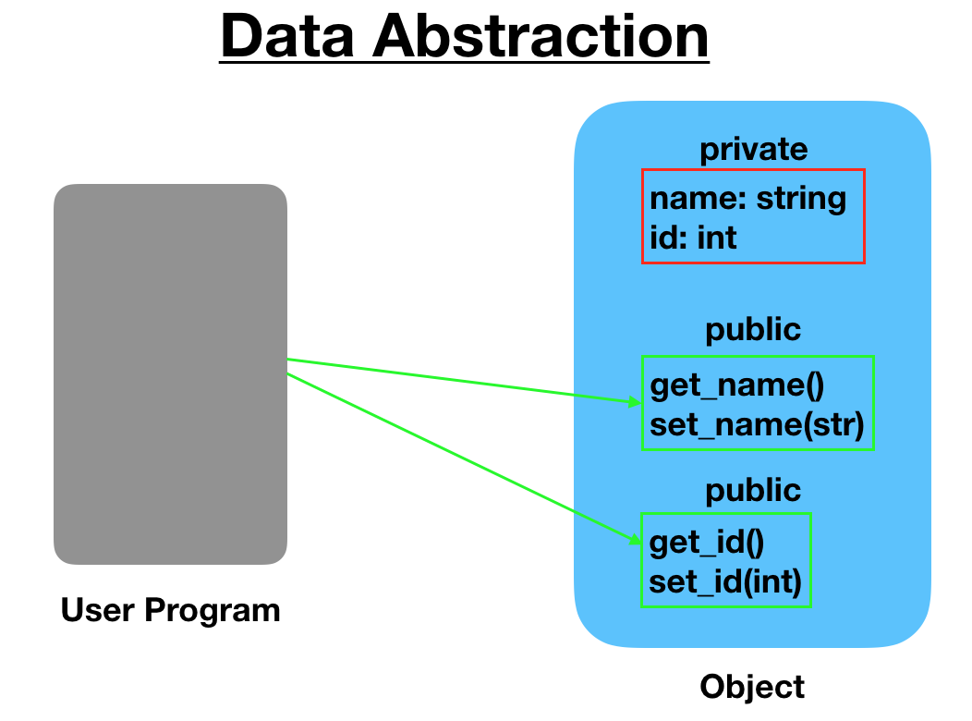
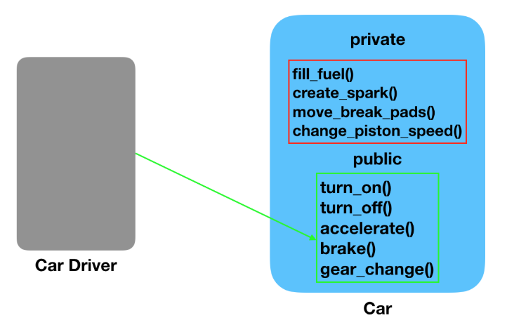
Abstraction
Abstraction
In modular approaches we have multiple level of abstractions
The Higher the level, more the abstraction is
Lower level shows the implementation details
Data abstraction
Procedural abstraction

Slide 13
Refinement
Abstraction and refinement are complimentary concepts
Refinement means going into the details of the system via idea refinement
Refine the requirement by decomposing it
until it reaches to the state where it clearly elaborates the system.
Abstraction shows the procedures and data whereas the refinement shows the implementation and low level details

Slide 14

Stepwise Refinement
open
walk to door;
reach for knob;
open door;
repeat until door opens
turn knob clockwise;
walk through;
if knob doesn't turn, then
close door.
take key out;
find correct key;
insert in lock;
endif
pull/push door
move out of way;
end repeat

Slide 15
Separation of Concerns
Any complex problem can be more easily handled if it is subdivided into pieces that can each be solved and/or optimized independently
concern: a feature having some value for a stakeholder
Advantage: a problem takes less effort and time to solve if its broken into smaller pieces.
shown in other design concepts like refinement, modularity, functional independence, aspects.

Slide 16
Modularity
implementation of separation of concerns
Software is decomposed in to separately named addressable components called as modules
They are integrated to fulfil the set of requirements
Follow divide and conquer approach
Monolithic software (i.e., a large program composed of a single module) cannot be easily grasped by a software engineer.
The number of control paths, span of reference, number of variables, and overall complexity would make understanding close to impossible.
Advantages:
understanding easier
reduce the cost required to build the software.
This module break down must be to an optimum level because more modules leads to more integration cost.

Slide 17

Modularity: Trade-offs
What is the "right" number of modules
for a specific software design?
module development cost
cost of
software
module
integration
cost
optimal number
number of modules
of modules

Slide 18

Information Hiding
module
• algorithm
controlled
interface
• data structure
• details of external interface
• resource allocation policy
clients
"secret"
a specific design decision

Slide 19
Why Information Hiding?
Modularity leads to access of information to particular entities. i.e. encapsulation in Design
It ensures the access constraints to a local details
emphasizes communication through controlled interfaces
discourages the use of global data
results in higher quality software

Slide 20
Refactoring
Simplifies the design of a component without changing its behavior by eliminating redundant codes and designs that might lead to system failures.
So improves the internal structure of the system without disturbing the external behavior of the code

Slide 21
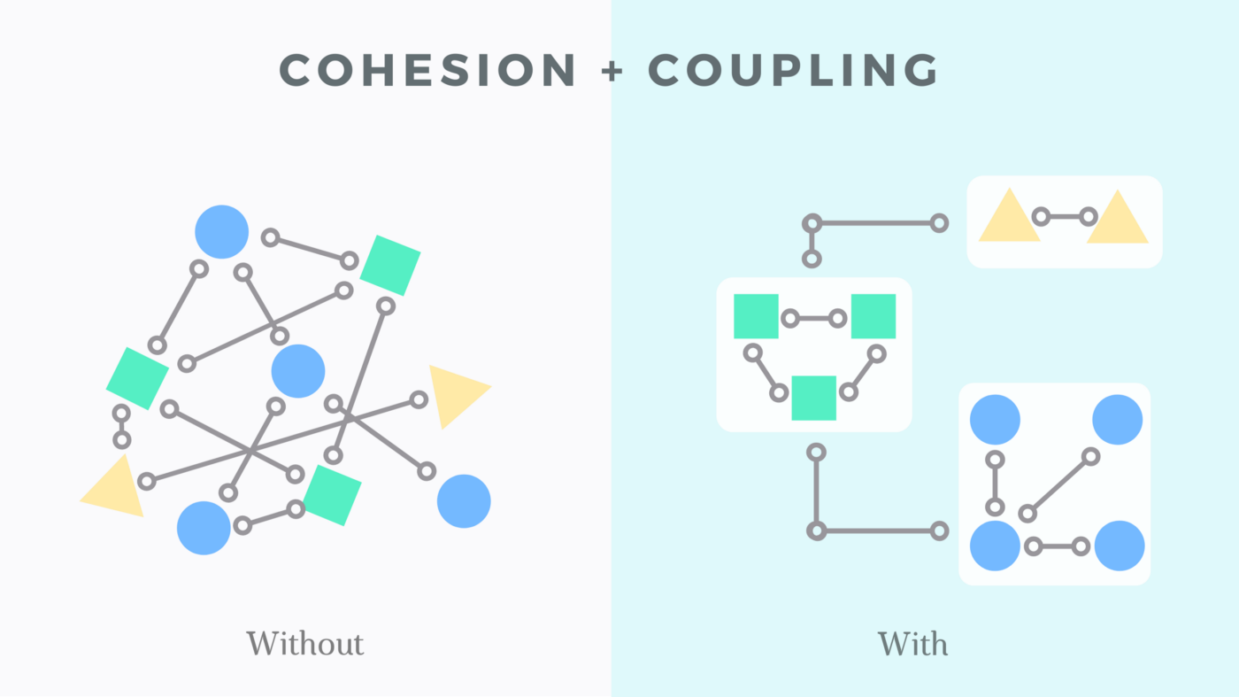



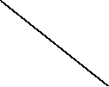











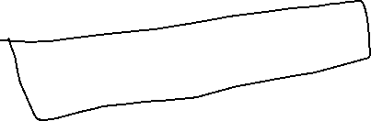



Functional Independence
Design a software in a way that each module addresses a subset of requirements and it has an interface when viewed from other modules.
Advantages:
Easy to develop
Easy task scheduling
Less error propagation chances
Reusable modules
Independence is assessed using two criteria:
Cohesion is an indication of the relative functional strength of a module.
A cohesive module performs a single task, requiring little interaction with other components in other parts of a program. Stated simply, a cohesive module should (ideally) do just one thing.
Coupling is an indication of the relative interdependence among modules.
Coupling depends on the interface complexity between modules, the point at which entry or reference is made to a module, and what data pass across the interface.

Slide 22
Aspects
Consider two requirements, A and B. Requirement A crosscuts requirement B “if a software decomposition [refinement] has been chosen in which B cannot be satisfied without taking A into account. [Ros04]
An aspect is a representation of a cross-cutting concern.

Slide 23
Aspects—An Example
Consider two requirements for the SafeHomeAssured.com WebApp.
Requirement A is described via the use-case Access camera surveillance via the Internet. A design refinement would focus on those modules that would enable a registered user to access video from cameras placed throughout a space.
Requirement B is a generic security requirement that states that a registered user must be validated prior to using SafeHomeAssured.com. This requirement is applicable for all functions that are available to registered SafeHome users.
As design refinement occurs, A* is a design representation for requirement A and B* is a design representation for requirement B. Therefore, A* and B* are representations of concerns, and B* cross-cuts A*.
An aspect is a representation of a cross-cutting concern. Therefore, the design representation, B*, of the requirement, a registered user must be validated prior to using SafeHomeAssured.com, is an aspect of the SafeHome WebApp.

Slide 24
OO Design Concepts
Design classes
Entity classes (represents system data)
Boundary classes (Objects that interface with system actors)
Windows, screens and menus are examples of boundaries that interface with users.
Controller classes (Objects that mediate between boundaries and entities.)
Inheritance—all responsibilities of a superclass is immediately inherited by all subclasses
Messages—stimulate some behavior to occur in the receiving object
Polymorphism—a characteristic that greatly reduces the effort required to extend the design

Slide 25
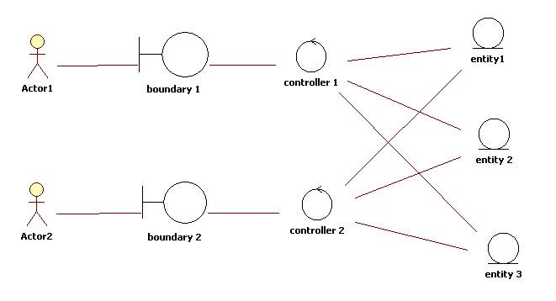
OO Design Concepts

Slide 26
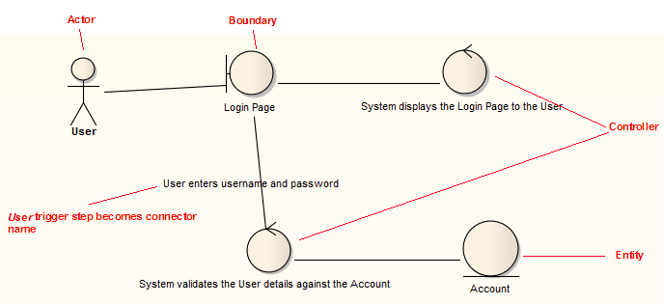
OO Design Concepts

Slide 27
Design Classes
Analysis classes are refined during design to become entity classes
Boundary classes are developed during design to create the interface (e.g., interactive screen or printed reports) that the user sees and interacts with as the software is used.
Boundary classes are designed with the responsibility of managing the way entity objects are represented to users.
Controller classes are designed to manage
the creation or update of entity objects;
the instantiation of boundary objects as they obtain information from entity objects;
complex communication between sets of objects;
validation of data communicated between objects or between the user and the application.

Slide 28
The Design Model

Slide 29
Design Model Elements
Data elements
Data model --> data structures
Data model --> database architecture
Architectural elements
Application domain
Patterns and “styles”
Interface elements
the user interface (UI)
external interfaces to other systems, devices, networks or other producers or consumers of information
internal interfaces between various design components.
Component elements
Deployment elements

Slide 30
Data Design Elements
Creates a model of data represented at a higher level of abstraction
Users/customers’ view of data
After that, refined to more implementation-specific representation that can be processed by the system(like creation and storage of values in an Relational DB)
Data architecture has an impact on software architecture
(as an effective design may lead to efficient processing)
Data elements are important because the translation of data model to the database at the application level is an integral part of the design
Moreover, efficient data storage may result in a data warehousing
That may lead to data mining or knowledge discovery via insights’ extraction which has an impact on business success

Slide 31

Architectural Design Elements
architectural design shows the overall view of the software system.
Architectural model is derived from:
Information about the application domain for which the software is being built
Requirement elements like dataflow diagrams, relationship or collaboration diagrams
The availability of architectural styles (e.g., data-centered arch. , OO arch, layered architectures)
Usually depicted as a set of interconnected subsystems
Which are derived from work packages of the requirements
Each subsystem may have its own architecture design

Slide 32
Interface Elements
As detailed drawings show the inner view of the plan
likewise, the interface elements show the information flows into and out of the system. And how that information is communicated among system modules.
3 important elements of interface design are:
UI design (for managers)
External interface to other devices/components/consumers
Internal interfaces between various components (different screens in a module)
Tools like adobe Xd, Figma, etc. could be used
It encompasses:
the aesthetic elements(layout , color scheme, visuals)
Ergonomic elements (UI navigation, information placement)

Slide 33
Interface Elements
External interface design must incorporate input validation and security.
Interfaces could be modeled as the external visualizers of public operations of class without showing the internal implementation details.

Slide 34
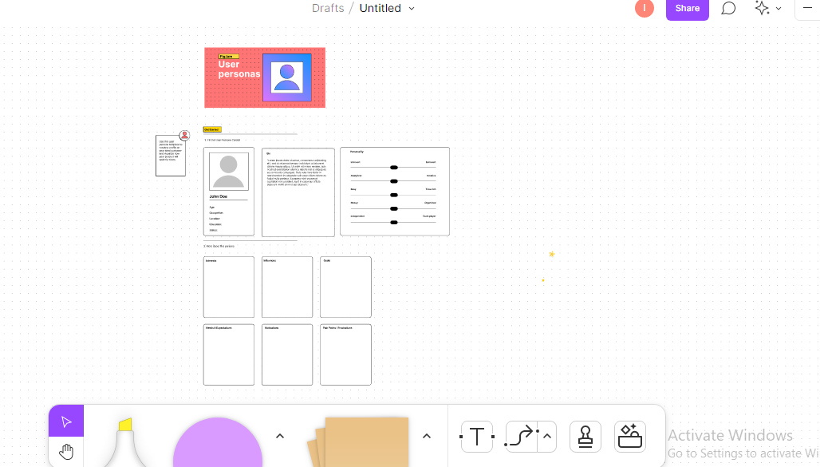
Interface Elements

Slide 35
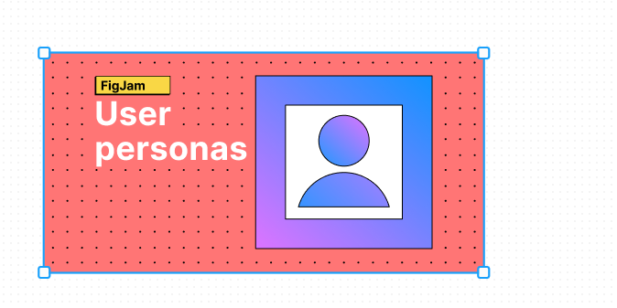
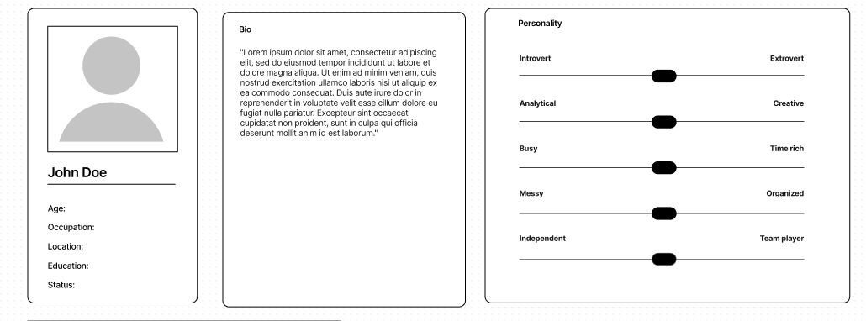
Interface Elements

Slide 36
Component Elements
In software design, component design is equivalent to a set of detailed drawings for a room.
Describes internal details of a software component
It defines :
Data structures for all local data objects (depends on nature of the object)
Algorithmic details of the process occurs in a component (shown using activity diag. / flowcharts/pseudocode)
Interface which allows access to all component operations

Slide 37
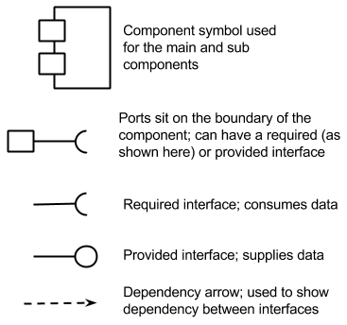
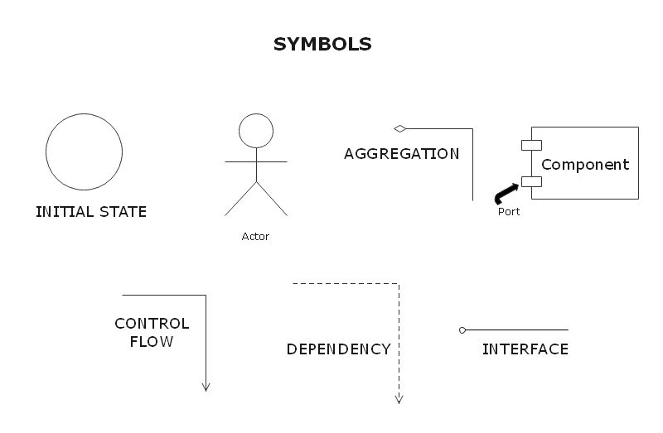
Component Elements

Slide 38
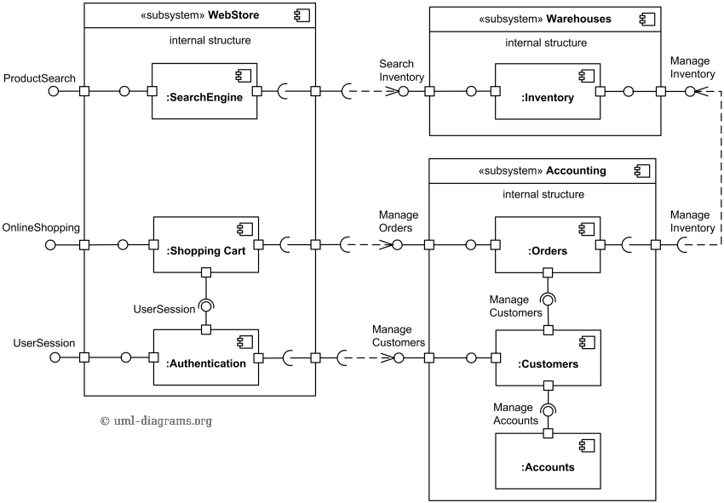
Online shopping UML component diagram example with three related subsystems - Webstore, Warehouses, and Accounting

Slide 39
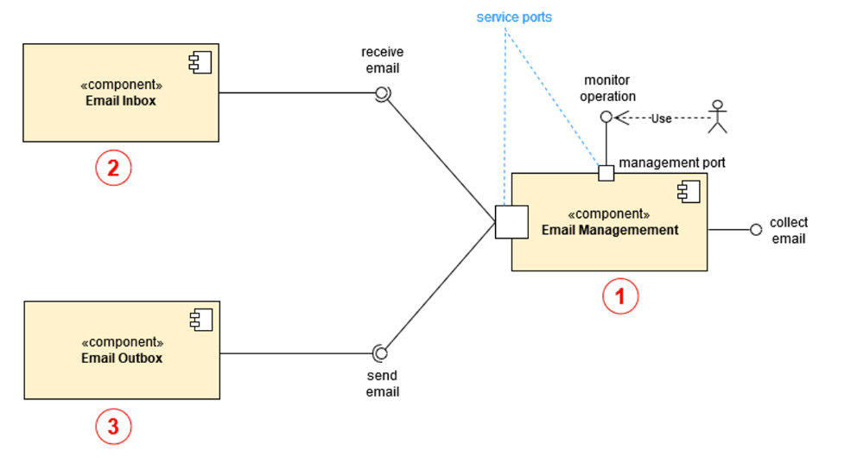
Component Elements
External interface
Assembly connectors

Slide 40
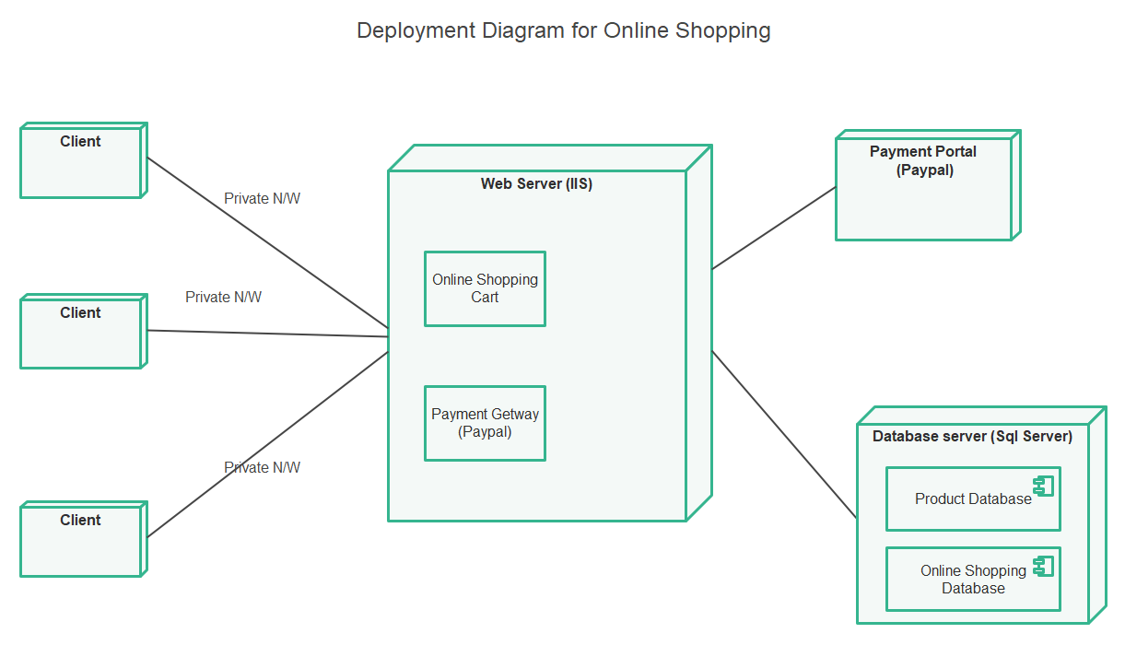
Deployment Elements
Shows what are the physical computing environment in which the software functionality and the subsystems operate. Distributed or standalone environment

